Slide 1
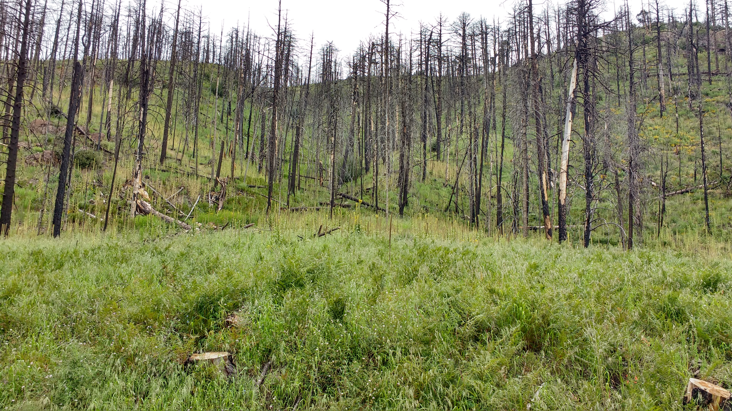
Ectomycorrhizal recovery from fire in geographically isolated sky islands

Slide 2
Background: Disturbances
Disturbance assists in maintaining species diversity Peay et al. 2009
Favors species that are poor competitors Peay et al. 2009
Fire has been shown to significantly affect soil chemistry and nutrient avail.
Neary et al. 1999; Certini 2005; Hart et al. 2005
Loss of organic material
Short term and long term changes in nutrients

Slide 3
Background: Ectomycorrhizal fungi
Ectomycorrhizal (EM) fungi are important components of forest ecosystems
Read & Smith 1997
Derive carbon from host plants in exchange for water and nutrients
Read & Smith 1997
Fire reduces the number and diversity of underground EM propagules
Peay et al. 2009
There are fire adapted fungi – Rhizopogon spp. , Wilcoxina spp.

Slide 4
Major questions/hypotheses
Questions:
Do ectomycorrhizal communities in spatially separated forests show a similar pattern of recovery from fire disturbance?
If not, what could be the underlying cause (e.g. is it stochastic, based on available species pool, historical)?
Hypotheses:
Burned sites will show higher diversity than unburned.
Geography will have a stronger influence than burn status on the structure of the EM community.

Slide 5
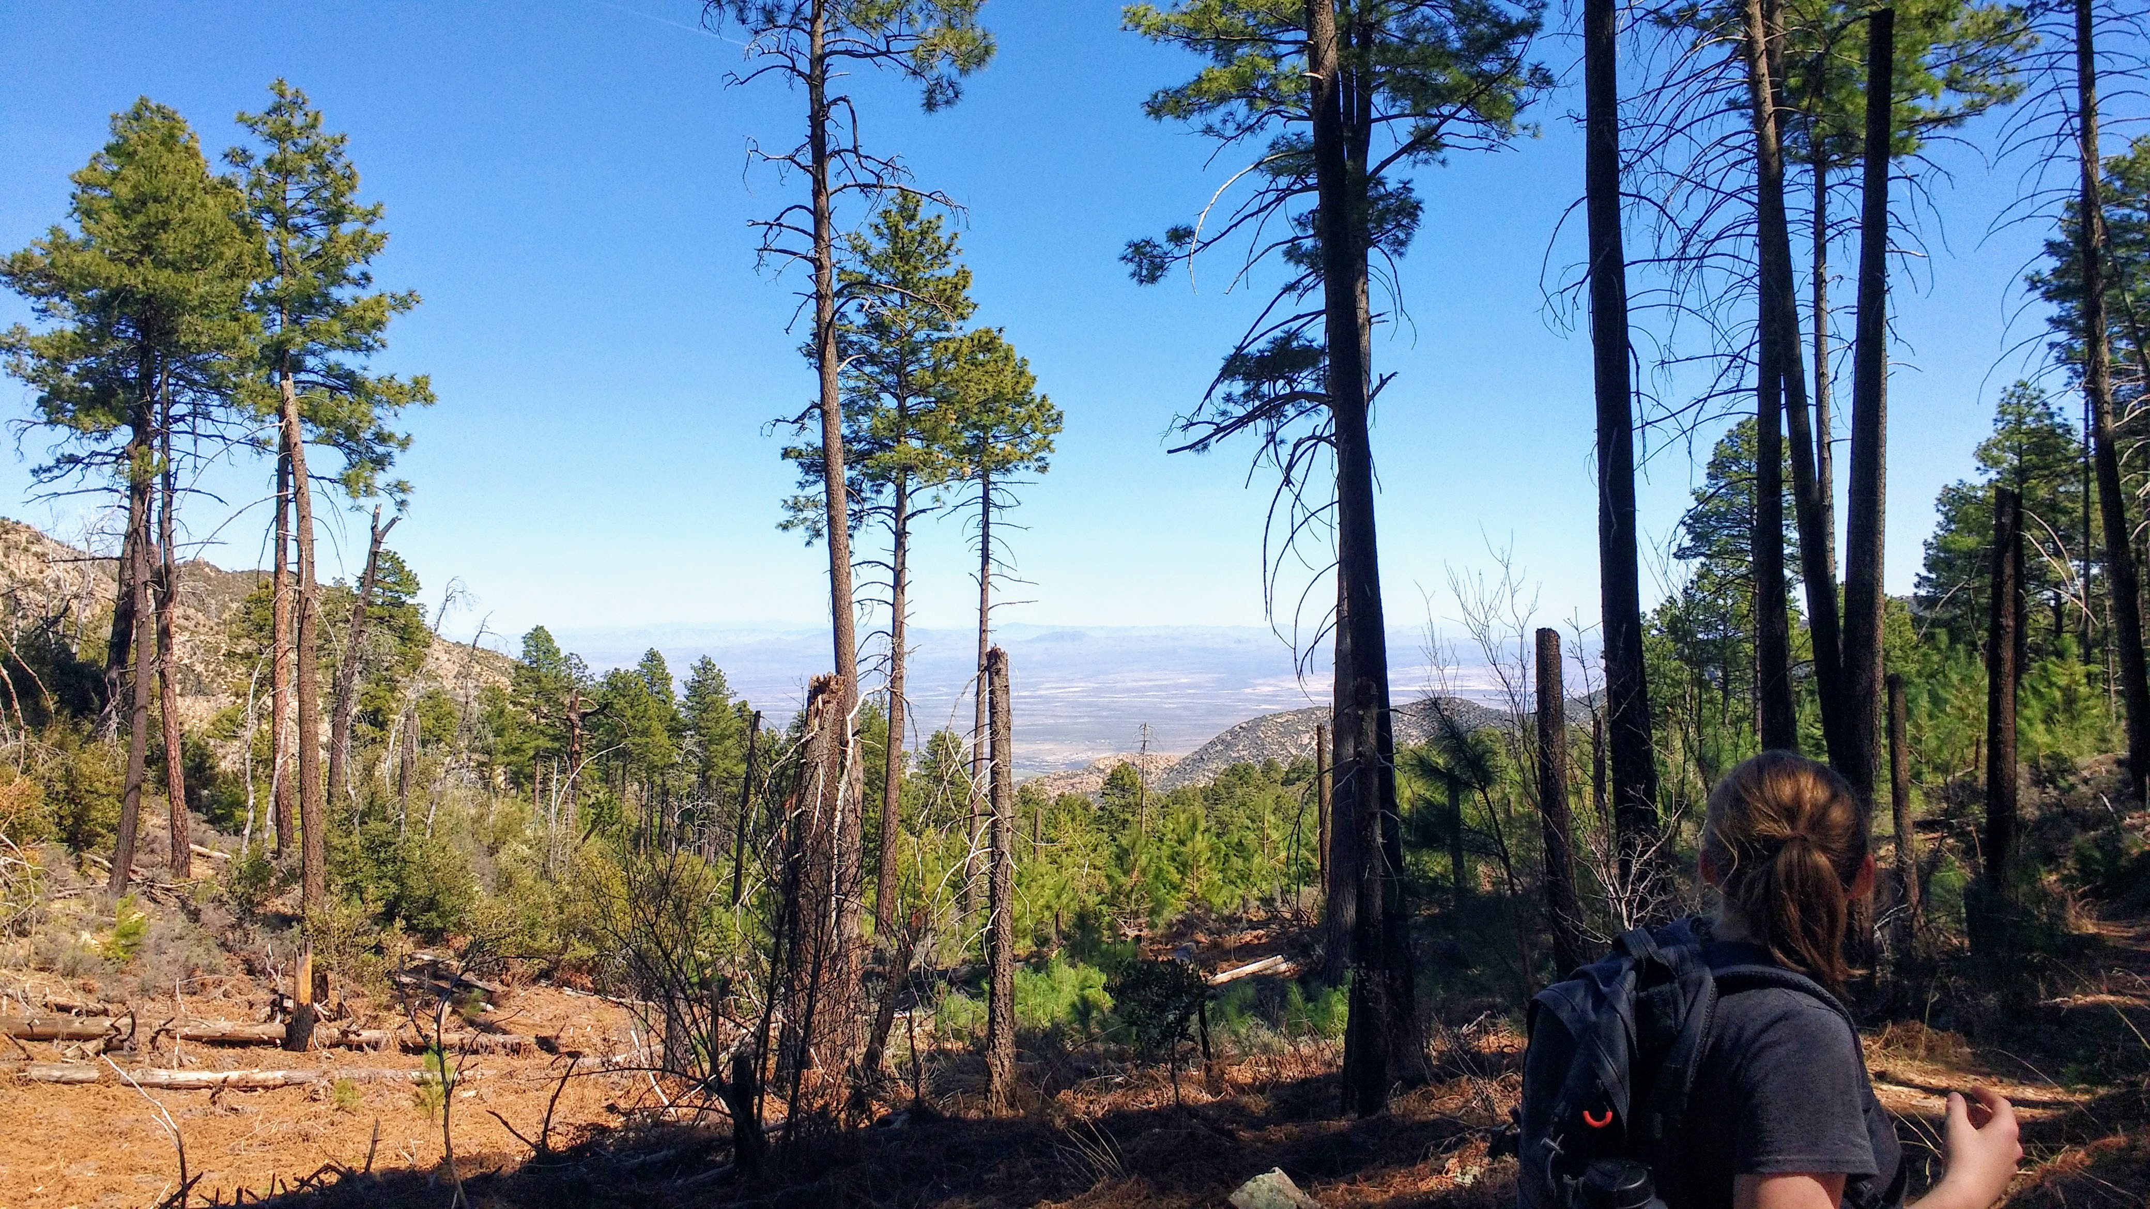
Background
We sampled in the Pinaleno and Santa Catalina Mts
Located at a similar latitude
Both ranges experienced burns ~ 14 years ago.
2004 Nutall-Gibson complex
2002 Bullock Fire
2003 Aspen Fire`

Slide 6
Sampling
Santa Catalina Mts.
Pinaleno Mts.
6 trees per site
3 root cores per tree (15 cores per site)
3 soil cores per site
5 trees per site
3 root cores per tree (15 cores per site)
3 soil cores per site
Burned
X2
X2
6 trees per site
3 root cores per tree (15 cores per site)
3 soil cores per site
5 trees per site
3 root cores per tree (15 cores per site)
3 soil cores per site
Unburned
X2
X2

Slide 7
Range differences: Diversity
Pinaleno Mts.
Santa Catalina Mts.
Pinaleno Mts.
Santa Catalina Mts.
Notes:
Burn status sig. different
Grouped by site

Slide 8
Range differences: Diversity
 | Fisher’s alpha |  | Shannon’s index
ANOVA | F-Value | P-value | F-Value | P-value
Burn status | 4.9418 | 0.03417* | 7.4707 | 0.009561*
Range | 1.2954 | N.S. | 0.0466 | 0.830240
Burn status: range | 0.6771 | N.S. | 0.1716 | 0.681079
Notes:
Burn status sig. different
Grouped by site

Slide 9
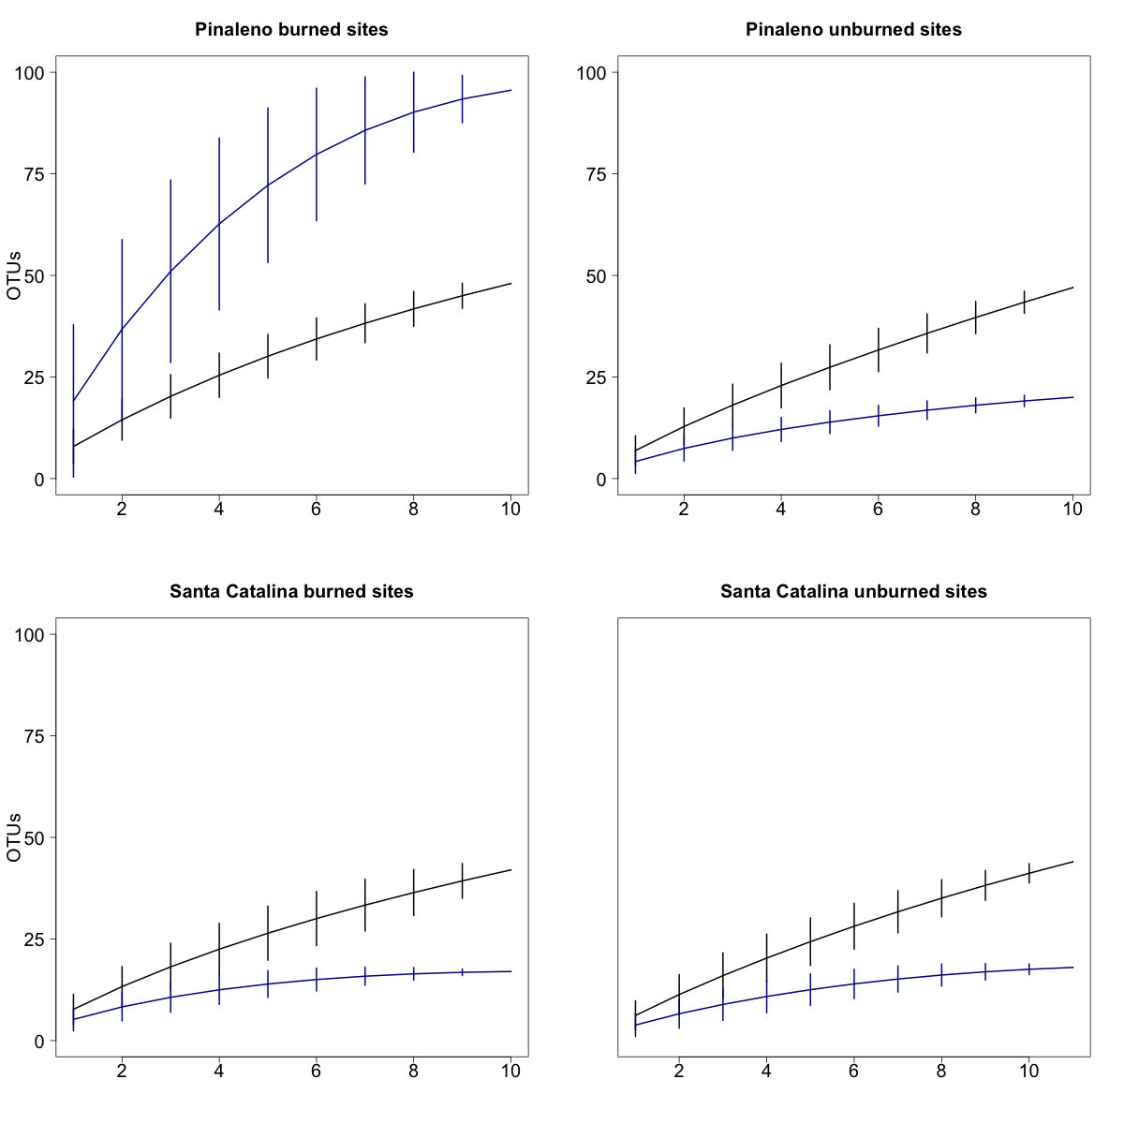
Species accumulation curves
Pinaleno Mts. - burned
Pinaleno Mts. - unburned
Santa Catalina Mts. - burned
Santa Catalina Mts. - unburned
Notes:
Burn status sig. different

Slide 10
Taxonomic differences: class level
Pinaleno Mts.
Santa Catalina Mts.
Chi-square test:
N.S.
Burned
Unburned
Burned
Unburned
Notes:
No difference

Slide 11
Taxonomic differences: genus level
Pinaleno Mts.
Santa Catalina Mts.
Pinaleno Mts.
Santa Catalina Mts.
Burned
Unburned
Burned
Unburned
Burned
Unburned
Burned
Unburned
Chi-squared test: X₂₈ = 54.541; p-value = 0.00193
Notes:
Range: Pearson's Chi-squared test data: range.tax
X-squared = 43.527, df = 18, p-value = 0.0006738

Slide 12
Range differences: Climate

Slide 13
Range differences: Soil difference based on burn

Slide 14
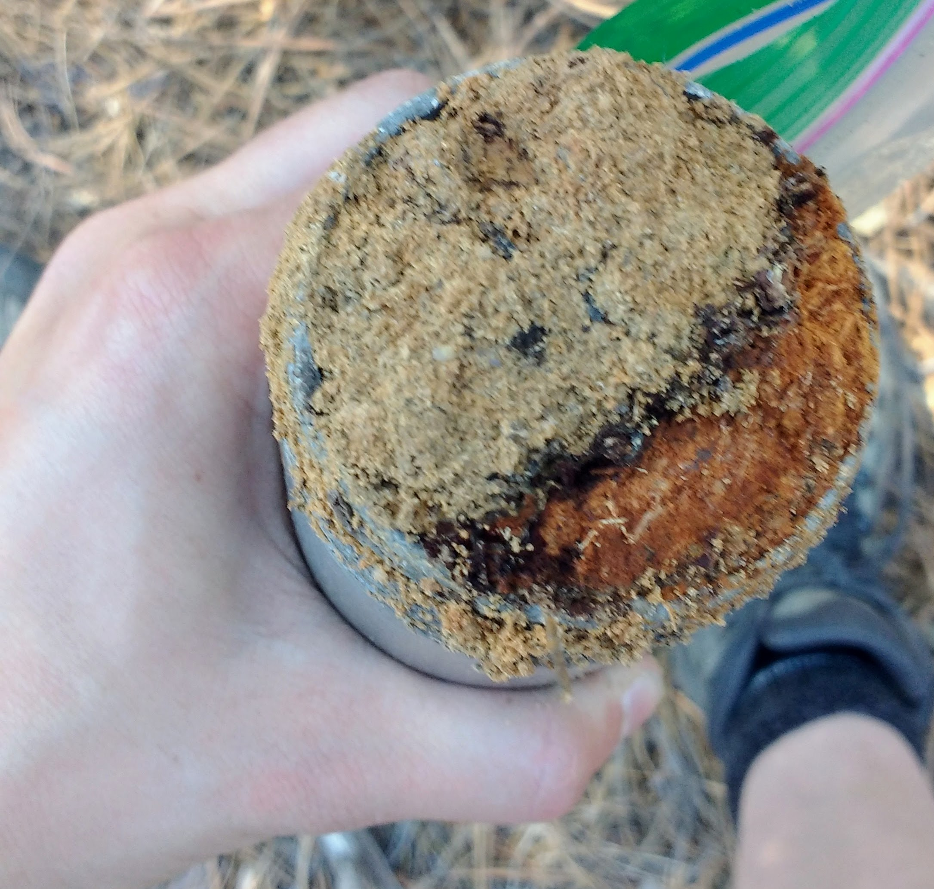
Range differences: Soil difference based on burn
Soil characteristics

Slide 15
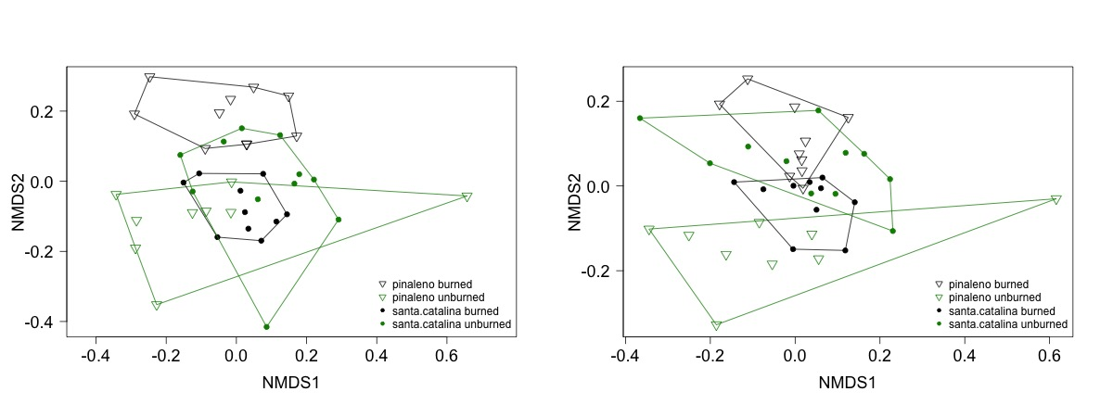
Community similarities
Jaccard dissimilarity index
Morisita dissimilarity index
stress = 0.1727
stress = 0.1796
ANOSIM:
R= 0.2730, p = 0.001
ANOSIM:
R= 0.2582, p = 0.001

Slide 16
Community similarities
Jaccard dissimilarity index
Morisita dissimilarity index
Notes:
ph and po4.ppm correlated
**Change phosphate to PCA of all soil characteristics

Slide 17
What is causing the differential recovery?
Environmental causes?

Slide 18
What is causing the differential recovery?
Environmental causes
Both ranges have similar soil responses to fire
There is a significant difference in soil characteristics between ranges
Mantel r = 0.3462
p = 0.001

Slide 19
What is causing the differential recovery?
Environmental causes
Both ranges have similar soil responses to fire
There is a significant difference in soil characteristics between ranges
Climatic difference between ranges
Climatic variable | T-statistic | Degrees of freedom | P-value
Avg. temp. warmest quarter | -0.9144 | 5.5650 | 0.3984
Avg. temp. coldest quarter | -4.0145 | 5.7427 | 0.0077*
Annual precipitation | -6.2444 | 4.7527 | 0.0019*
Notes:
**Change to Annual avg. high and annual avg. low temperature instead of wamest/coldest quarter.

Slide 20
What is causing the differential recovery?
Environmental causes
Both ranges have similar soil responses to fire
There is a significant difference in soil characteristics between ranges
Climatic difference between ranges
 | Jaccard |  | Morisita
Variable | R² | P-value | R² | P-value
Range | 0.0599 | 0.0010* | 0.0691 | 0.0010*
Phosphate | 0.0571 | 0.0010* | 0.0818 | 0.0010*
Precipitation | 0.0574 | 0.0010* | 0.0636 | 0.0010*
Range:phosphate | 0.0360 | 0.0280* | 0.0302 | 0.0999
Range:precipitation | 0.0494 | 0.0010* | 0.0512 | 0.0080*
Phosphate:precipitation | 0.0327 | 0.0450* | 0.0403 | 0.0210*
All | 0.0448 | 0.0030* | 0.0426 | 0.0130*
Total | 0.3373 |  | 0.3486

Slide 21
What is causing the differential recovery?
Environmental causes
Both ranges have similar soil responses to fire
There is a significant difference in soil characteristics between ranges
Climatic difference between ranges
Species pool within ranges
Different species pools will affect what is available to colonize
It seems that the same genera are present → finer taxonomic scale

Slide 22
What is causing the differential recovery?
Environmental causes
Both ranges have similar soil responses to fire
There is a significant difference in soil characteristics between ranges
Climatic difference between ranges
Species pool within ranges
Different species pools will affect what is available to colonize
Pool all unburned EM data for EM in both Santa Catalina and Pinaleno Mts.
Look to see if the community compositions of these two ranges are different

Slide 23
Conclusions
Functional role of dominant EM fungi
Primary and secondary EM colonizers

Slide 24
Questions/suggestions?

Slide 25
Abundance
ECM root biomass
(ECM root biomass + non-ECM root biomass)
X 100

